Slide 1

CSS An Overview
Athoug Alsoughayer

Slide 2
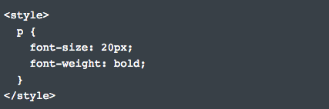
1. Ways to add CSS to a page
There are different ways we can add CSS to a page
Inline Styles
When we write inline styles, we write the CSS in the HTML file, directly inside an element's tag using a style attribute.
Internal Styles
Internal styles are embedded in the <head> section of the HTML document and are defined inside a <style> tag.

Slide 3
Linking to an external style sheet
The “rel” attribute specifies the relationship between the HTML document and the linked document. The “href” attribute points to the location of the CSS file.
Using @import
The @import statement must precede all other CSS rules in a style sheet in order for it to work properly.

Slide 4
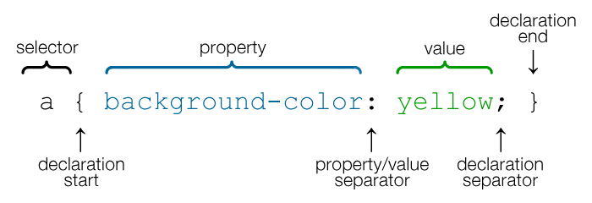
2. CSS Selector
Selectors are one of the most important and powerful parts of CSS because they let us target the content we want to style. When we define a selector in our stylesheet, we’re instructing the browser to match every instance of that selector in the HTML.
CSS Syntax

Slide 5

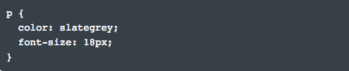
3. The different kinds of selectors
1. Type Selector
Type selectors target element types on the page. They’re also called element selectors because we use the element’s HTML tag as the selector.
Using type selectors to target the footer element and change its background color, we can write the following CSS rule:
To target all paragraphs on the page, we can use a type selector:
Reference: Type Selectors - MDN

Slide 6

2. ID Selectors
Unlike a type selector, which targets every element with the corresponding element type, an ID selector lets us assign a unique ID to an element.
ID selectors are declared using the pound (#) symbol, followed by the ID name.
This selector will match the HTML element that has an ID attribute with the value primary-content.
IDs are unique to the page, so an element can only have one ID and a page can only have one element with the same ID name.
Reference: ID selectors

Slide 7

3. Class Selectors
Class selectors let us target elements based on their class attribute. The main difference between a class and an ID selector is that IDs are unique and they’re used to identify one element on the page, whereas a class can target more than one element.
Using class selectors
Class selectors are defined with the . character followed by the class name.
Besides being able to target more than one element with a single class selector, an element can also have multiple classes assigned to it.

Slide 8
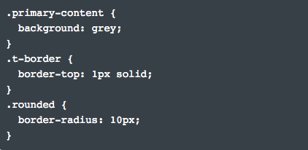
Example of reusing classes
At times, we may have a lot of repeated CSS in our style sheets. So it's best to create classes for the repeated styles.
Space-separate each class name in the class attribute:
Then, target each class in the style sheet:

Slide 9
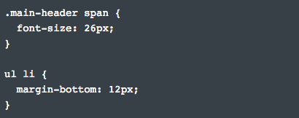
4. Descendant Selectors
CSS lets us target elements based on their relationship in the HTML document. We can combine selectors to create descendant selectors that target elements that are descendants of an element. This makes our selectors more specific.
Examples of descendant selectors
To create a descendant selector, we’ll need to use two or more selectors separated by whitespace:
Reference: Descendant selector

Slide 10

4. Pseudo-Classes
Pseudo-classes are similar to classes, but they’re not explicitly defined in an element's class attribute. Unlike type, ID and class selectors, pseudo-classes can target elements dynamically based on user interaction, an element’s state, and more.
Using pseudo-classes
Think of a pseudo-class as a keyword we add to a selector to style a special state of an element. The :link pseudo-class targets links that have not been visited by the user:

Slide 11



The :visited pseudo-class targets links that have been visited –– or clicked –– by the user:
The :hover pseudo-class targets an element when a user hovers over it:
The :active pseudo-class gets applied when an element is in an active state:

Slide 12
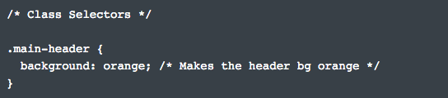
5. CSS Comments
Just like in HTML, we can write comments in CSS to add helpful notes and hints that let us know what's going on in our code.
Using CSS comments
Comments in CSS begin with a forward-slash and asterisk /* and end with an asterisk and forward slash */. Everything we write between the opening and closing characters is ignored by the browser.
Reference: CSS Comments

Slide 13
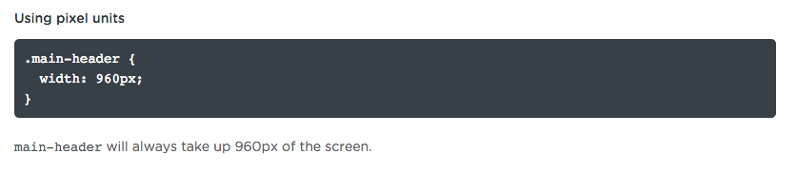
6. Common Data Types
Pixel Units
When we use pixel units, the size we define will always remain the same and will not scale, regardless of the browser window and size of the screen.

Slide 14
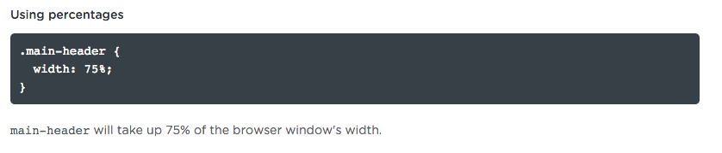
Percentages
We can define number values more fluidly with percentage units. Percentages, by nature, are always relative to something else. When we use a percentage unit in CSS, the percentage value is measured relative to a parent element's length.

Slide 15
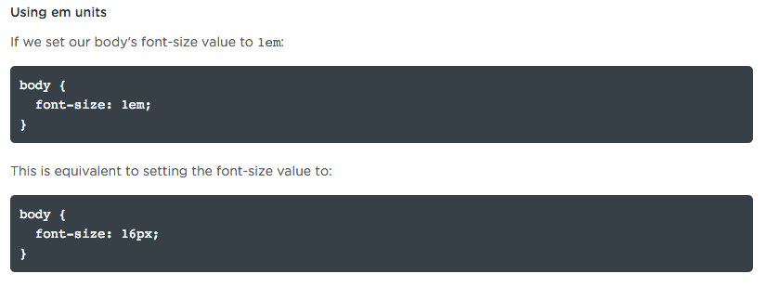
Em Units
Relative length units are relative to other length values. The most commonly used relative unit is the em unit. The em is known as a font-relative unit because it's calculated based on a parent element's font size.

Slide 16
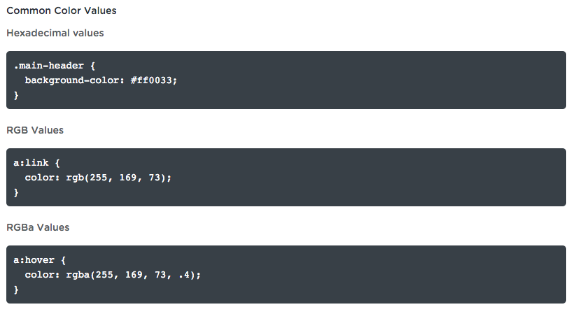
Color Values
Color plays an important role in web design. With CSS, we can describe a color value in different ways. The three most common ways are with a keyword, a hexadecimal value, or an RGB function.
Reference: Color Values

Slide 17
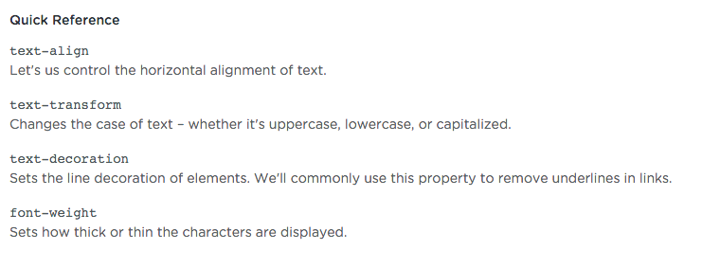
Text Styles
Text has a significant effect on how we view a web page. In this video, we'll cover common properties for defining text styles.

Slide 18
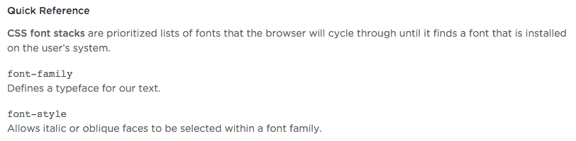
Font Properties
Like text properties, font properties let us change the appearance of text by assigning a font family, font size, font style, and more.

Slide 19
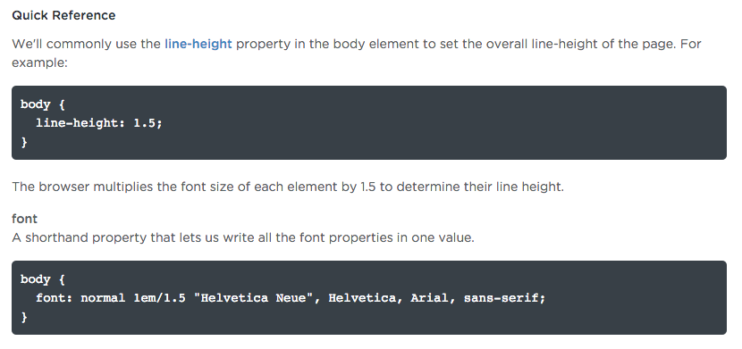
Line Height
With the line-height property, we can increase, or decrease, the vertical gaps between lines of text.

Slide 20
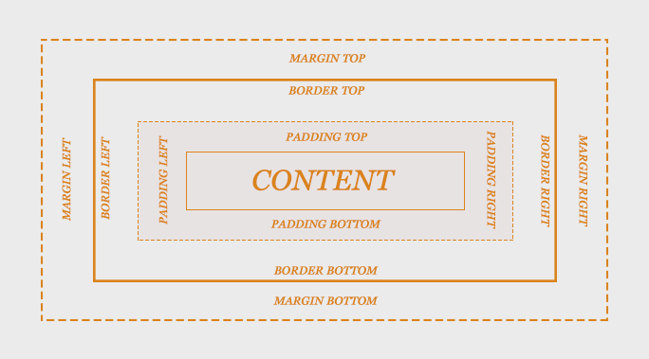
7. The CSS Box Model
The box model is what describes the amount of space each element takes up on the page. Let's dig a little deeper into this concept by going over the main components that make up the CSS Box Model.

Slide 21
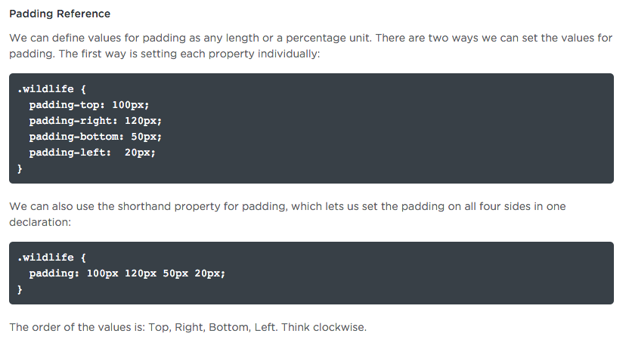
Padding
Padding is often used to give an element's content area some breathing room by separating the content from the surrounding border area.

Slide 22
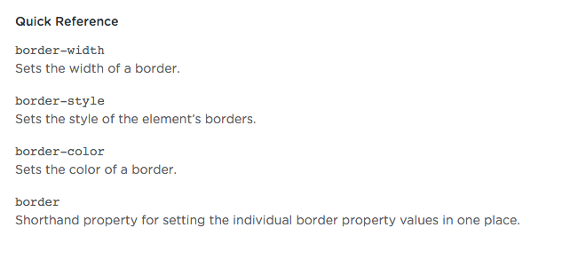
Borders
In this video, we'll cover three properties we can use to create and style borders.

Slide 23
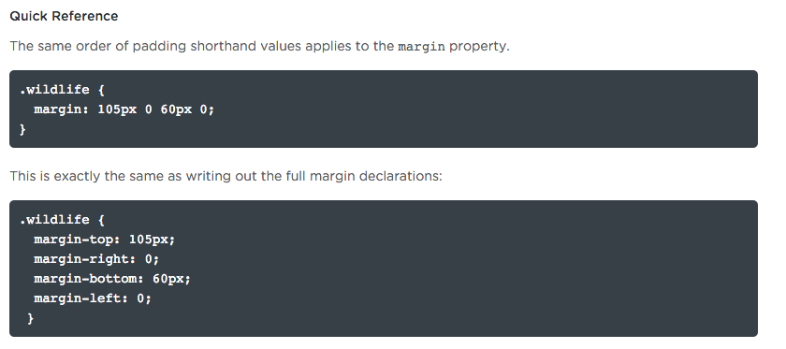
Margins
Margins affect the area outside a box. We commonly use margin properties to create space around elements.

Slide 24



Display Values
With the display property, we can override the default display settings of an element. The three most common types of display values.

Slide 25
8. Width and Height Properties
By default, an element's width and height are as wide or as tall as the content it holds. But we're able to set our own dimensions with the width and height properties.

Slide 26
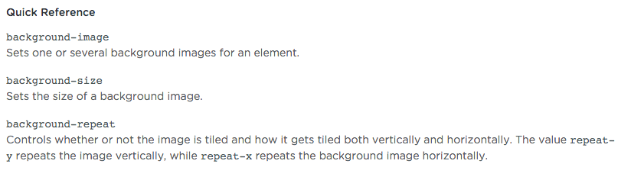
9.1 Backgrounds: Color and Images
Every HTML element has a background layer that is transparent by default.

Slide 27
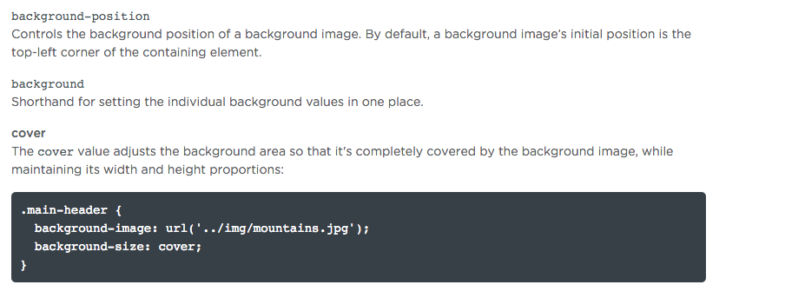
9.2 Backgrounds: Size and Position

Slide 28
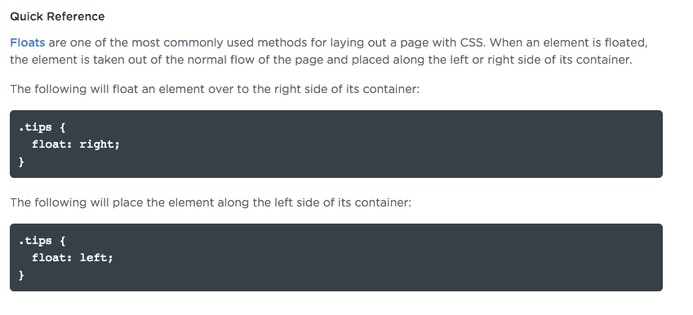
10. Floats
Clearing Floats
If a block element contains floated children, its height will collapse.

Slide 29
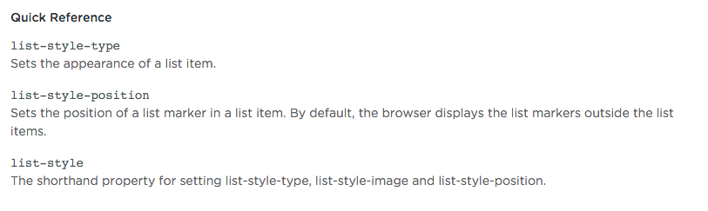
11. Lists

Slide 30
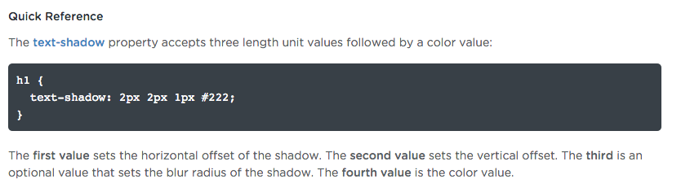
12. Text Shadows

Slide 31

Example using text shadow:
before using text shadow the file looks like

Slide 32


After adding text shadow the file looks like

Slide 33
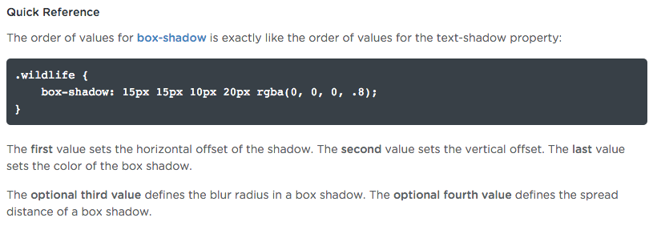
13. Box Shadows
Like text-shadow, we're able to cast shadows off elements with the box-shadow property.

Slide 34

Example using box shadow:
before using box shadow the file looks like

Slide 35
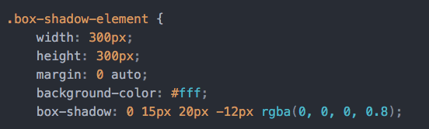

After adding box shadow the file looks like

Slide 36
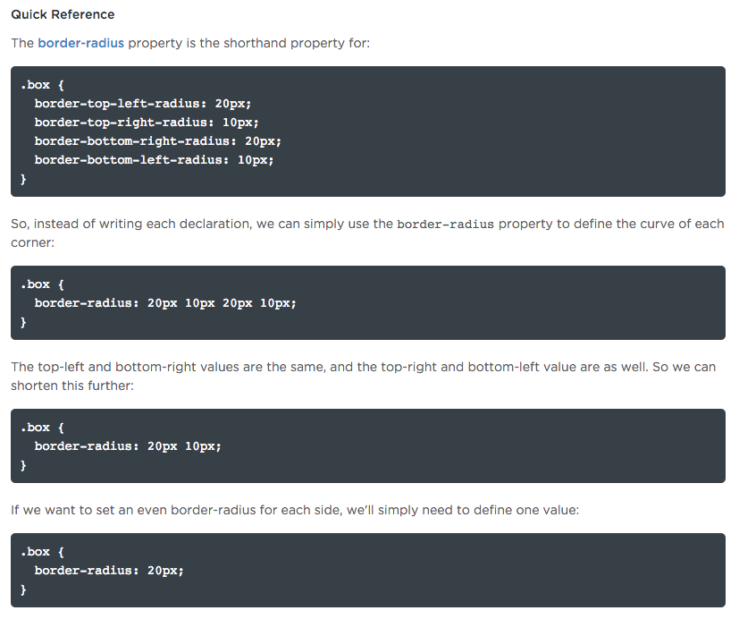
14. Border Radius
CSS has properties that let us create rounded corners on elements without the need for any images or extra markup. With border-radius, we can define exactly how rounded the borders appear.

Slide 37


15. Gradients
With CSS gradients, we can add depth to our designs by creating smooth and gradual transitions between two or more colors.

Slide 38
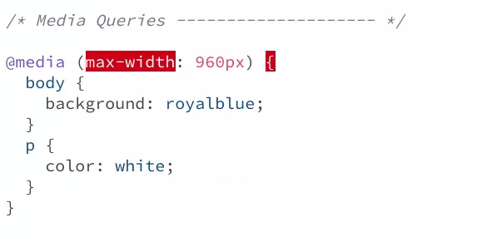
16. Media Queries
With media queries, we're able to enhance the browsing experience of websites on multiple devices and viewport sizes. This allows us to tailor our content to a wide range of devices without having to change anything in the HTML.

Slide 39
17. The Cascade: Importance
An important part of learning CSS is understanding how CSS rules are applied by the browser via the cascade. In CSS, the cascade is what determines which styles are assigned to an HTML element.

Slide 40
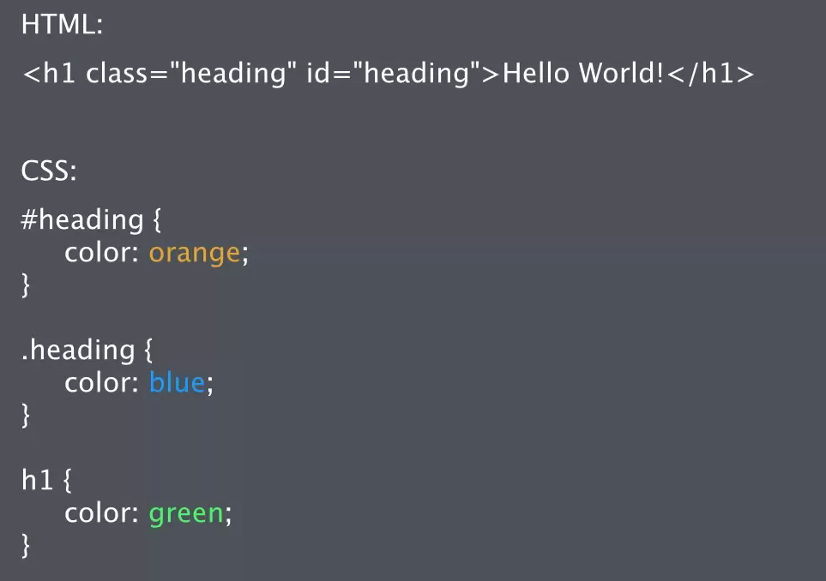

Slide 41
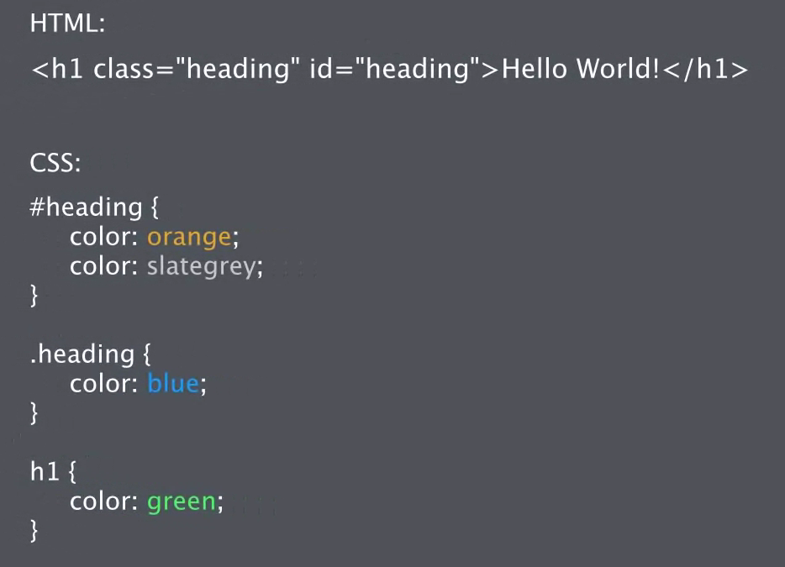

Slide 42
